Slide 1
Artificial Intelligence
Machine Learning
12 AUG 2026

Slide 2
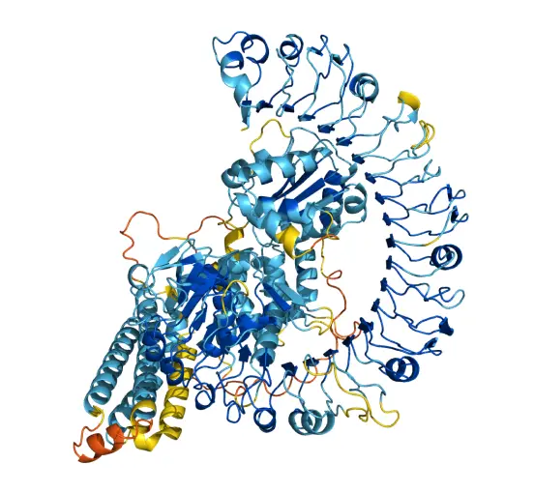
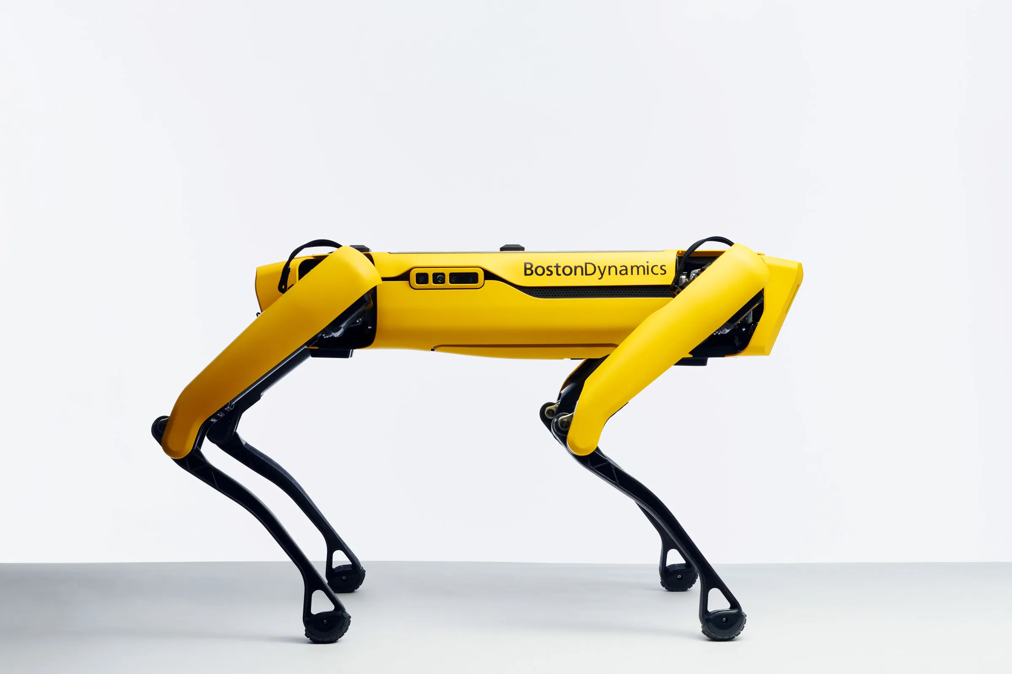
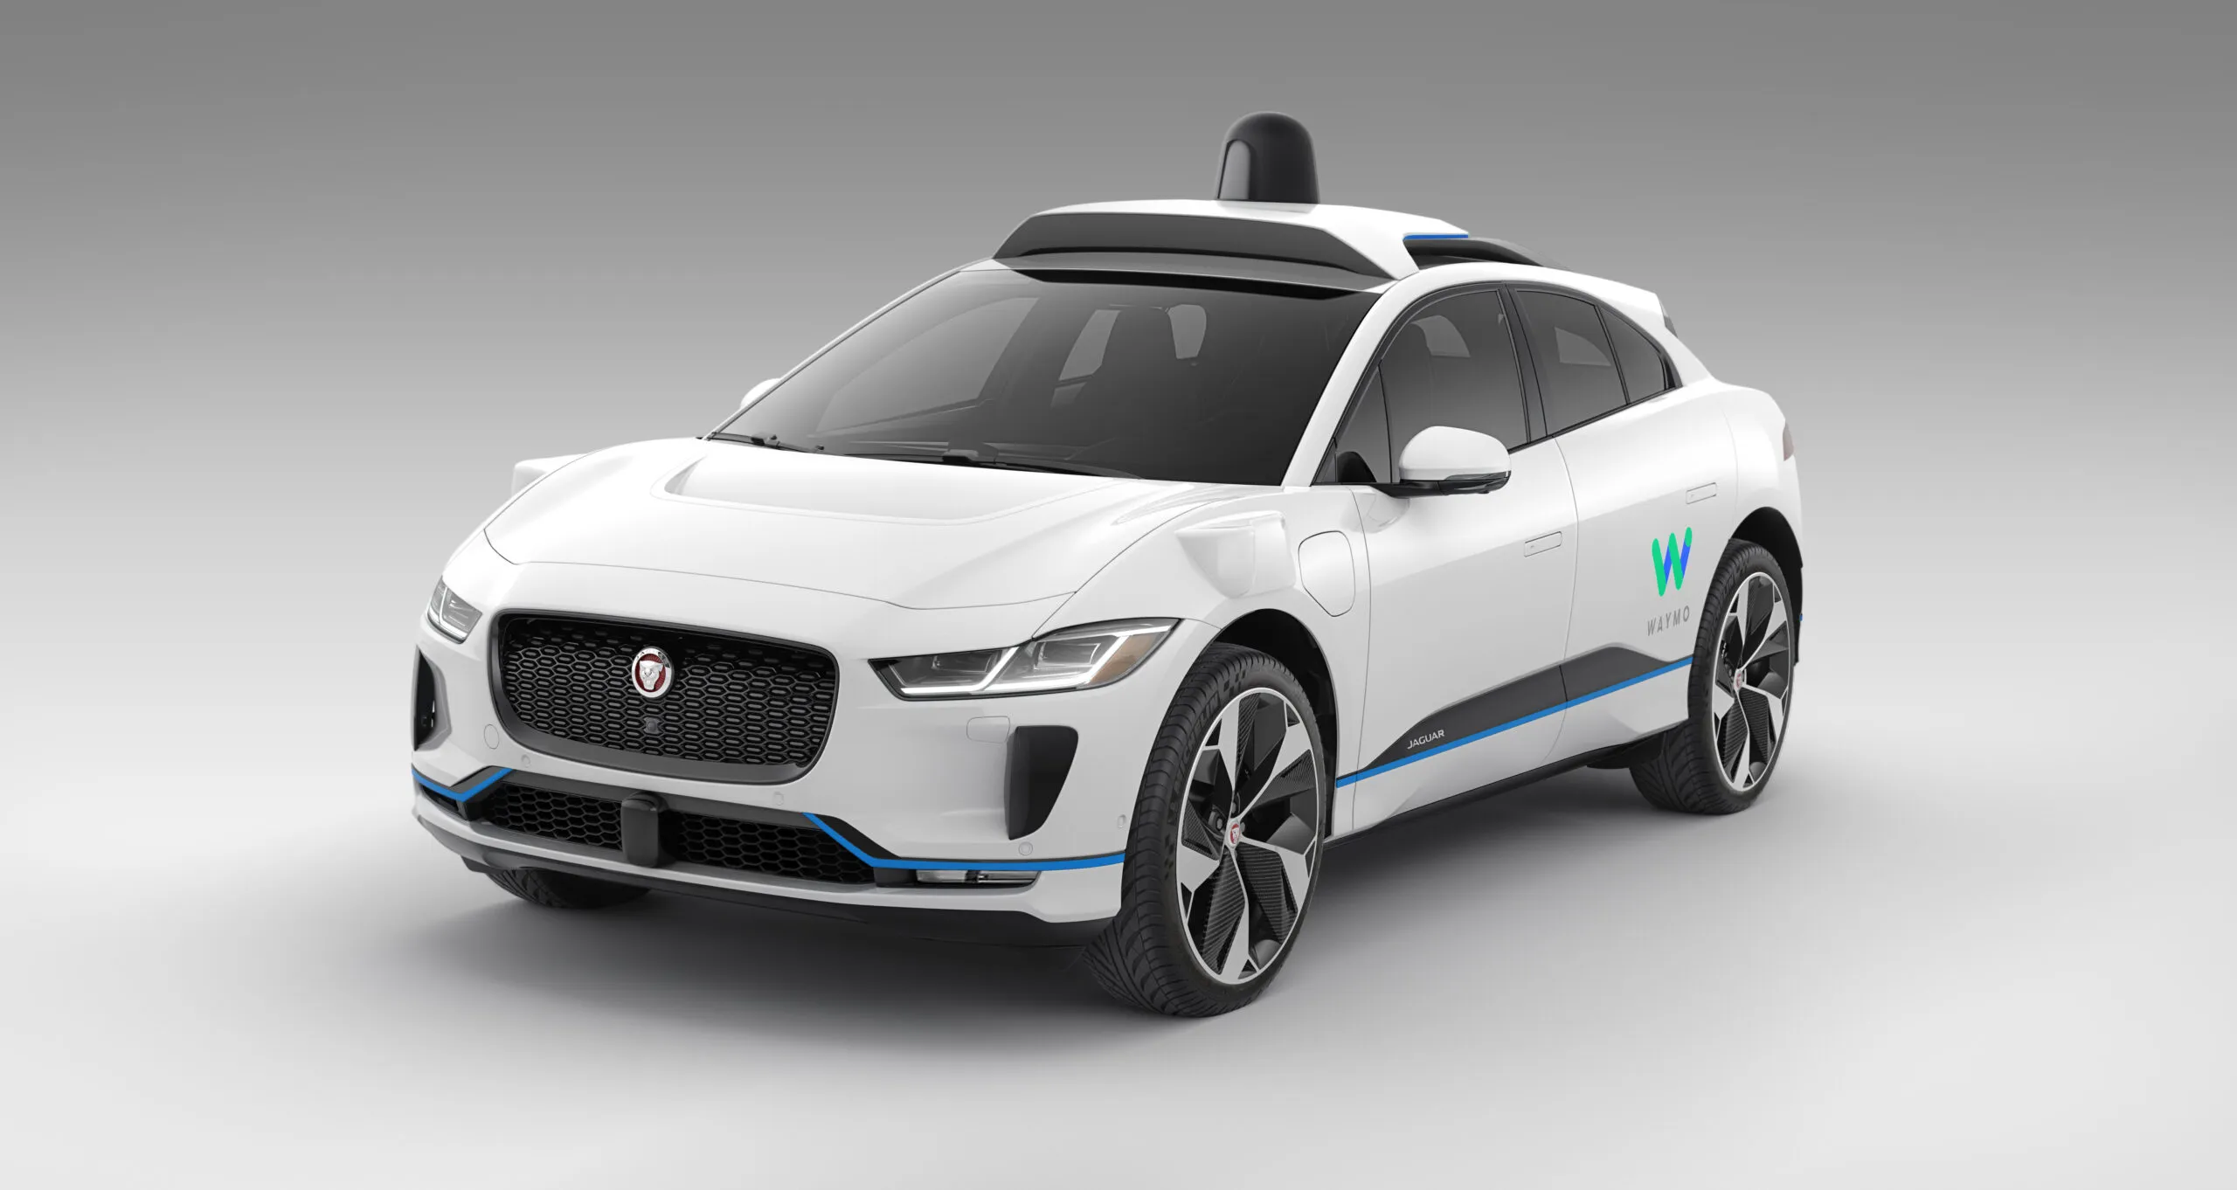
AI – current events
Automotive
Medical
Robotics

Slide 3

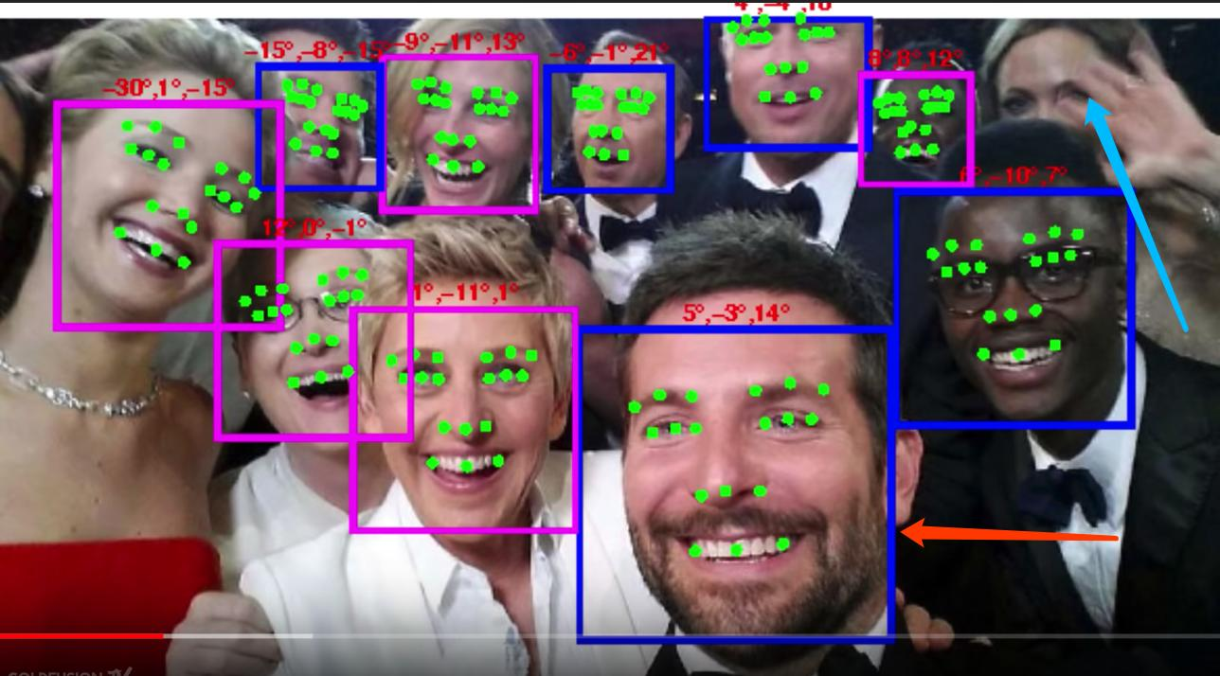
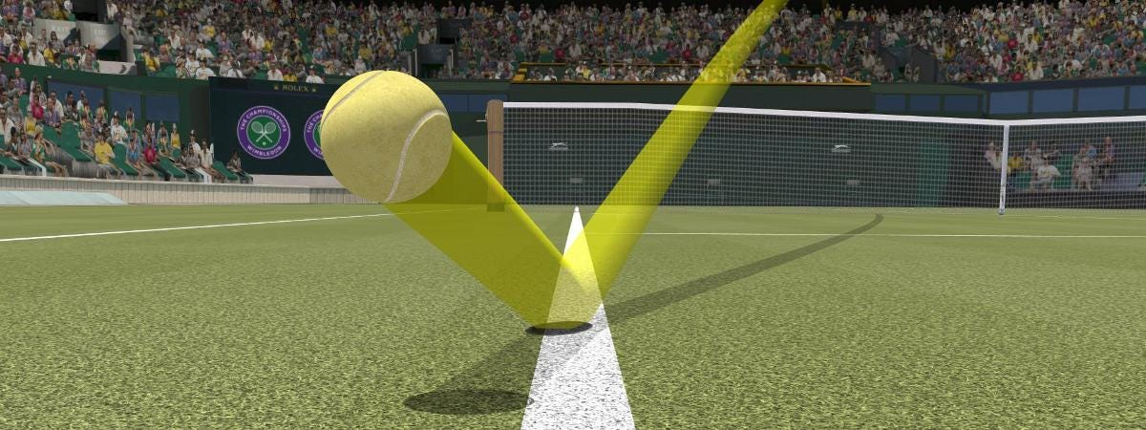
AI – current events
Manufacturing
Cybersecurity
Entertainment

Slide 4
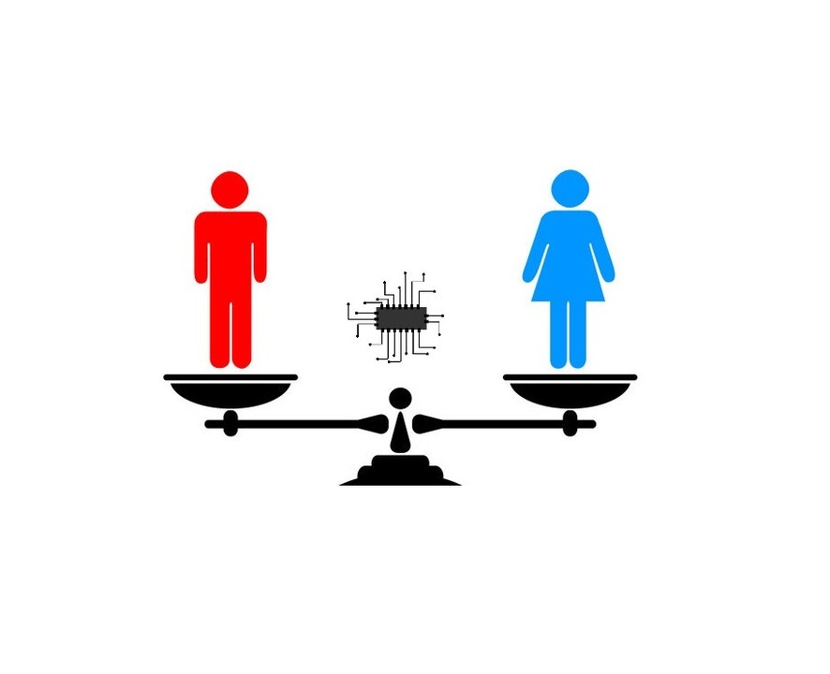

AI – Potential and biases
Risk models used in US courts have shown to be biased against non-white defendants
Some models to evaluate job applicants show bias in favor of male candidates

Slide 5
Lesson objectives
Explain how machine learning differs from traditional rule-based programming.
Differentiate between supervised, unsupervised, and reinforcement learning.
Implement a simple supervised learning model on a tabular dataset.

Slide 6
What is machine learning?
TRADITIONAL PROGRAMMING
MACHINE LEARNING
INPUT
INPUT
OUTPUT
GENERAL
PROGRAMMING
MACHINE LEARNING
OUTPUT
NEW
INPUT
LEARNED
PROGRAM
INFERRED
OUTPUT

Slide 7
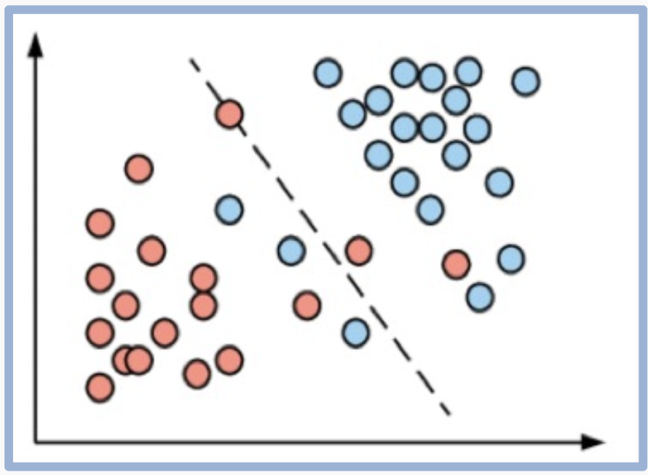
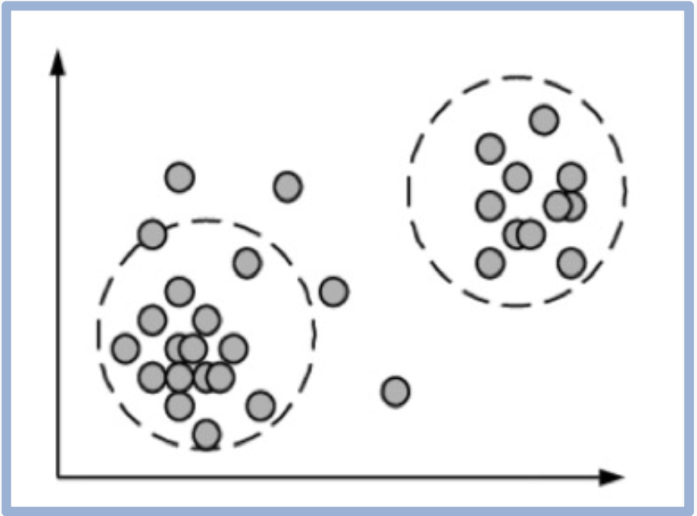
flavors of Machine learning
Supervised Learning: Learns with “labeled” data
Unsupervised Learning: Learns by association

Slide 8

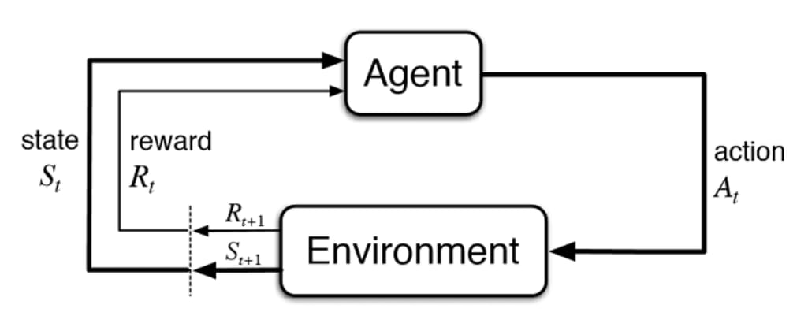
flavors of Machine learning
Reinforcement Learning: Learns by interacting with an environment

Slide 9
Exercise
For each scenario, decide what type of machine learning would be best:
Anomaly Detection:
A bank looks for unusual credit card transactions that do not fit the user’s normal spending patterns.
Spam Filter:
You feed the computer thousands of emails labeled “Spam” or “Not Spam” so it can learn to filter your inbox.
Robot Maze:
A robot learns to navigate a maze by trying different paths and receiving rewards when it gets closer to the goal.
Notes:
Bank: unsupervised ML
Spam: supervised ML
Robot Maze: reinforcement ML

Slide 10
supervised learning building blocks
SUPERVISED MACHINE LEARNING WORKFLOW
GET LABELED DATA
SELECT MODEL
DEFINE LOSS
FUNCTION
MINIMIZE LOSS
EVALUATION
Notes:
Tabular Data Set e.g. Rows and Columns

Slide 11
Response vs predictor variables
SUPERVISED MACHINE LEARNING WORKFLOW
GET LABELED DATA
Patient history vs heart disease
Sales vs advertising budget
(Response vs Predictor)
SELECT MODEL
DEFINE LOSS
FUNCTION
MINIMIZE LOSS
EVALUATION

Slide 12
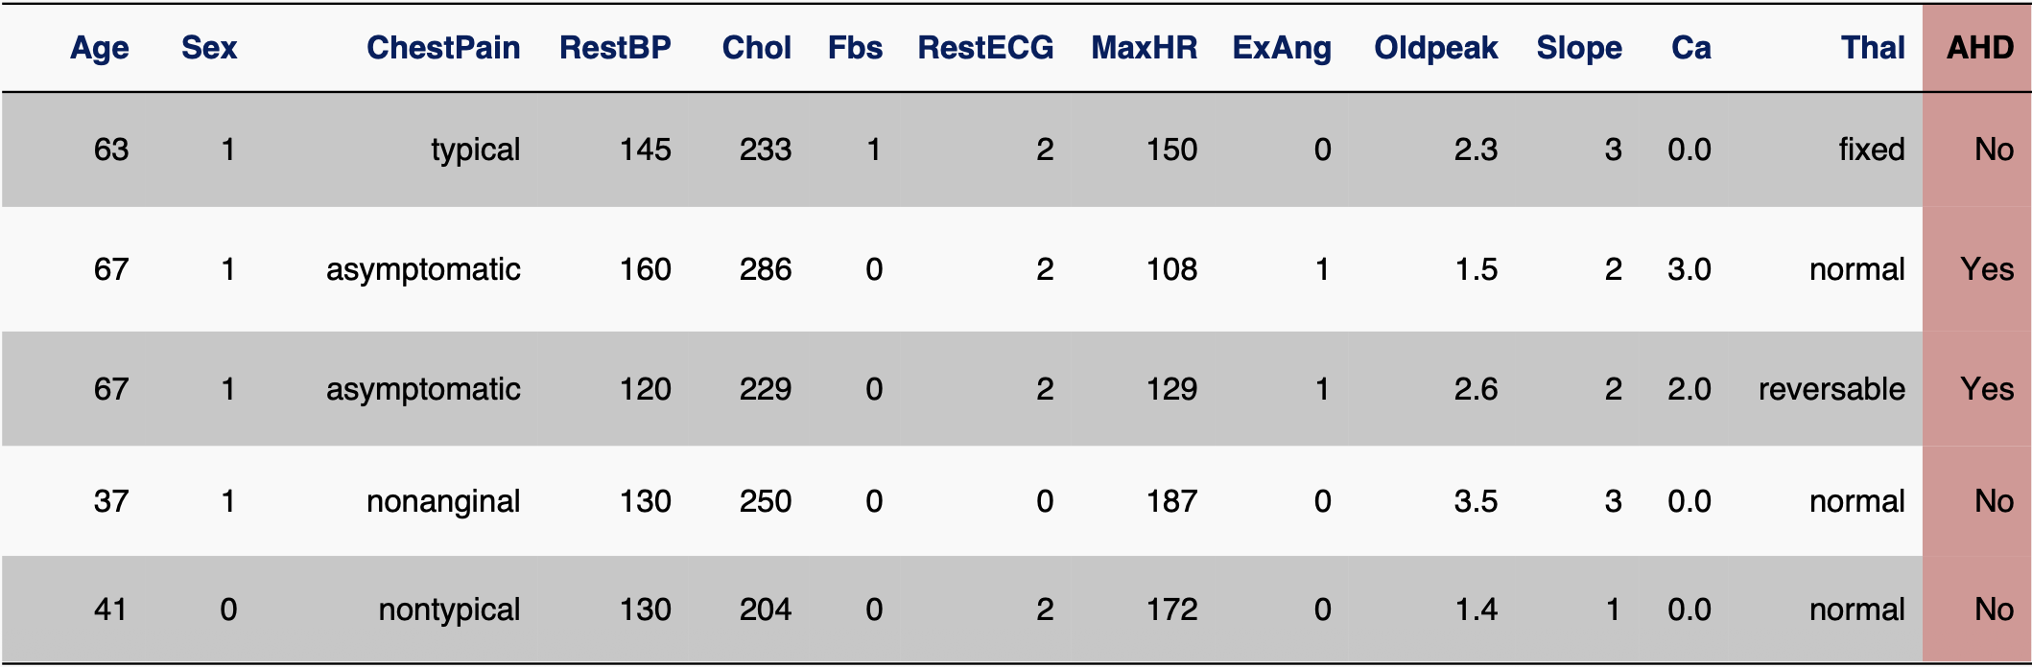
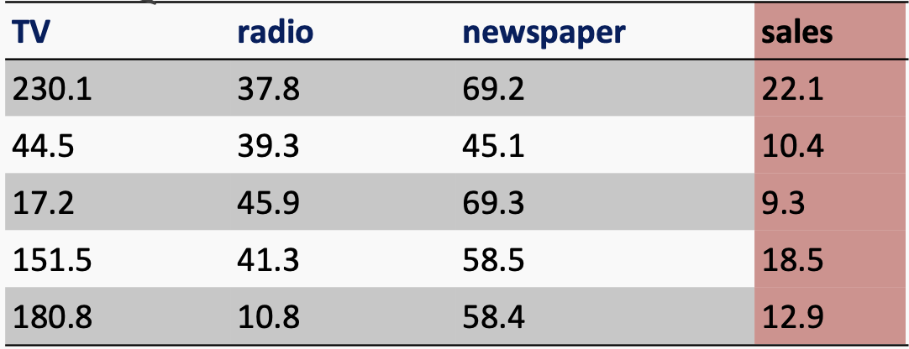
Response vs Predictor variables
Response variable is yes/no
Response variable is continuous

Slide 13
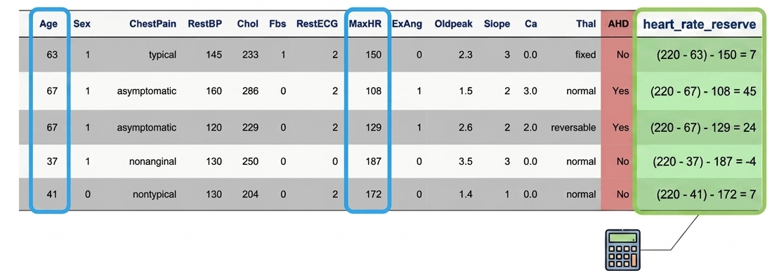
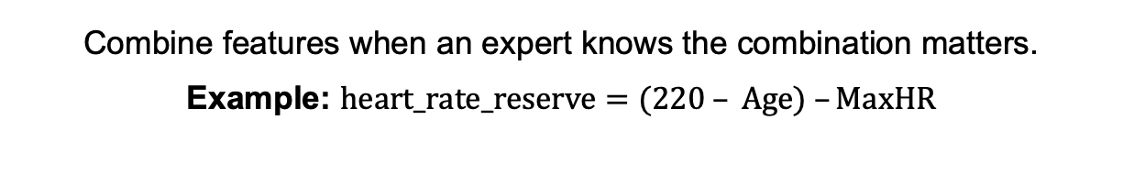
Feature engineering
Combine features when an expert knows the combination matters.
Example: $heart_rate_reserve=(220 – Age) –MaxHR$

Slide 14
Model selection
SUPERVISED MACHINE LEARNING WORKFLOW
GET LABELED DATA
Regression, Classification, etc.
SELECT MODEL
DEFINE LOSS
FUNCTION
MINIMIZE LOSS
EVALUATION

Slide 15
Model selection
SUPERVISED MACHINE LEARNING
Response variable is categorical e.g. yes/no
Response variable is continuous
CLASSIFICATION
REGRESSION
Logistic Regression
KNN
Decision Trees
…Many More
Linear Regression
Gradient Boosted Trees
Neural Networks
…Many More

Slide 16
Exercise
In 5 groups…
Research assigned algorithm. What type of machine learning is it? Briefly describe the algorithm and any application found.
Logistic Regression
Linear Regression
Decision Tree
Random Forests
K-Nearest Neighbor
Notes:
Logistic Regression: Supervised machine learning algorithm primarily used for classification problems. It is used for binary classification where the output can be one of two possible categories such as Yes/No, True/False or 0/1.

Slide 17
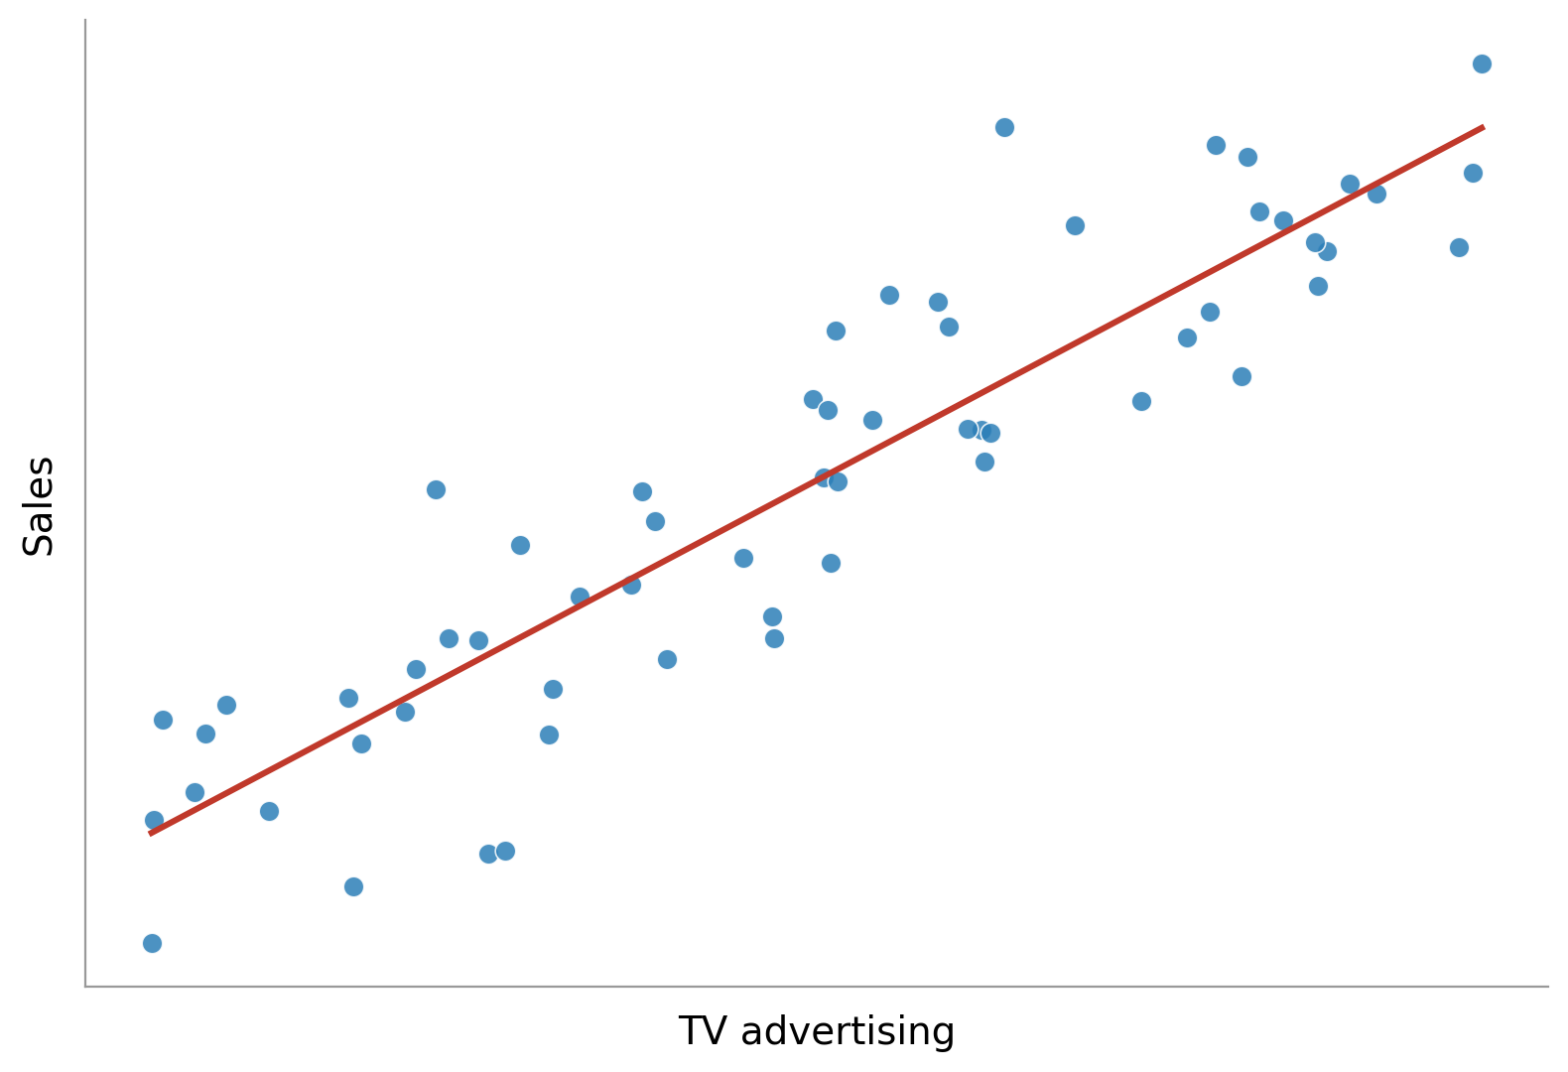
Linear regression
Represents the relationship between inputs and outputs as a straight line
The line is defined by two numbers – its steepness and position – called the model’s parameters
Uses the line to make predictions on new data

Slide 18
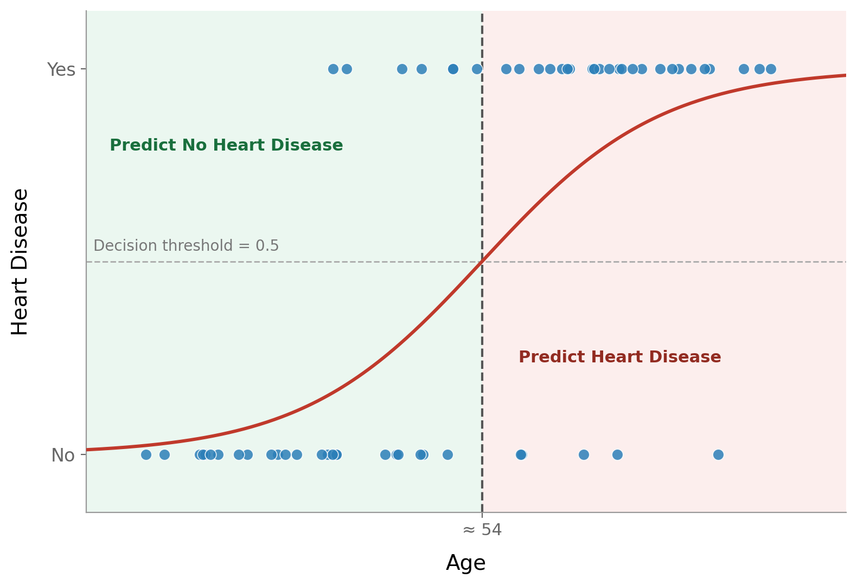
logistic regression
Represents the relationship between inputs and categories as an S-shaped “sigmoid” curve
The curve is defined by two numbers – its steepness and position – called the model’s parameters
Uses the curve to estimate the chance new data belongs to each category

Slide 19
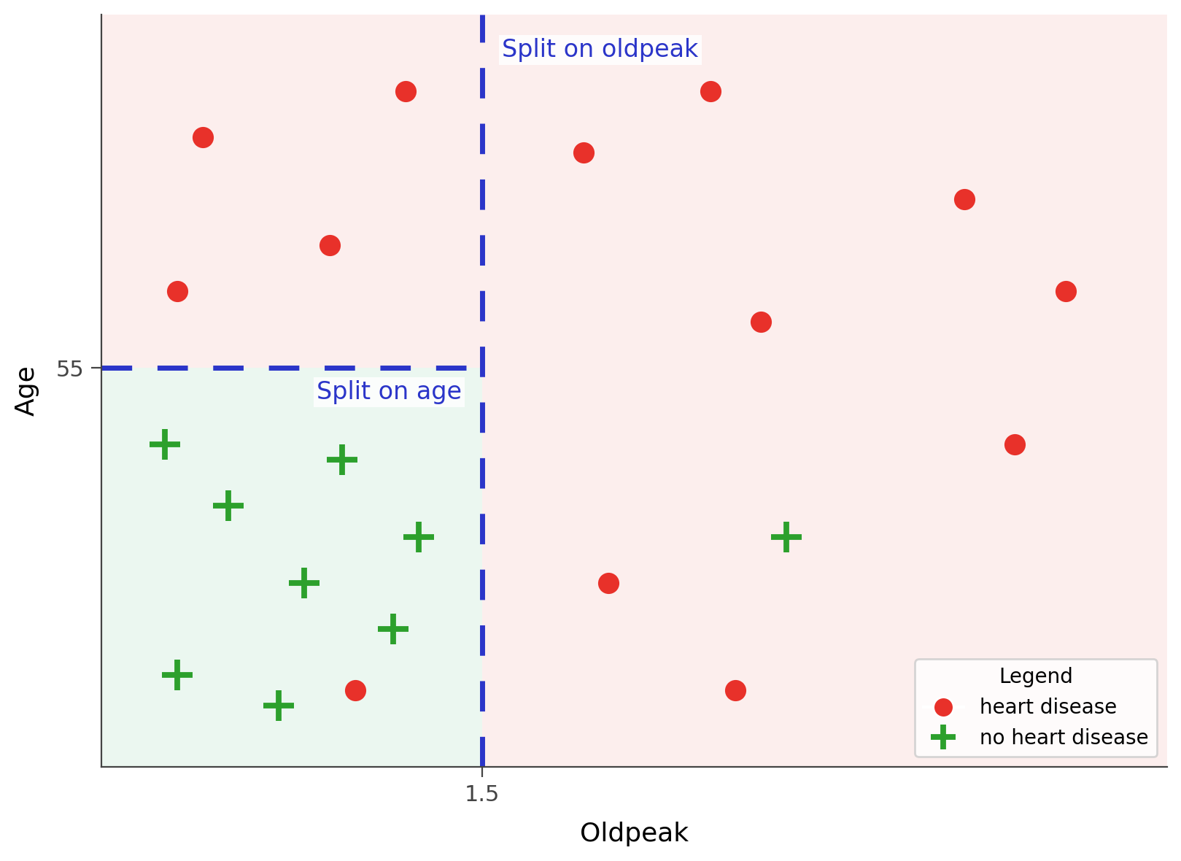
Decision tree
Oldpeak > 1.5?
No
Yes
Age > 55?
Heart Disease
No
Yes
No Heart Disease
Heart Disease
Makes predictions by asking a series of yes/no questions about the data
Partitions the example space with perpendicular decision boundaries

Slide 20
Loss function
SUPERVISED MACHINE LEARNING WORKFLOW
GET LABELED DATA
A single number that scores how wrong our predictions are
SELECT MODEL
DEFINE LOSS
FUNCTION
MINIMIZE LOSS
EVALUATION

Slide 21
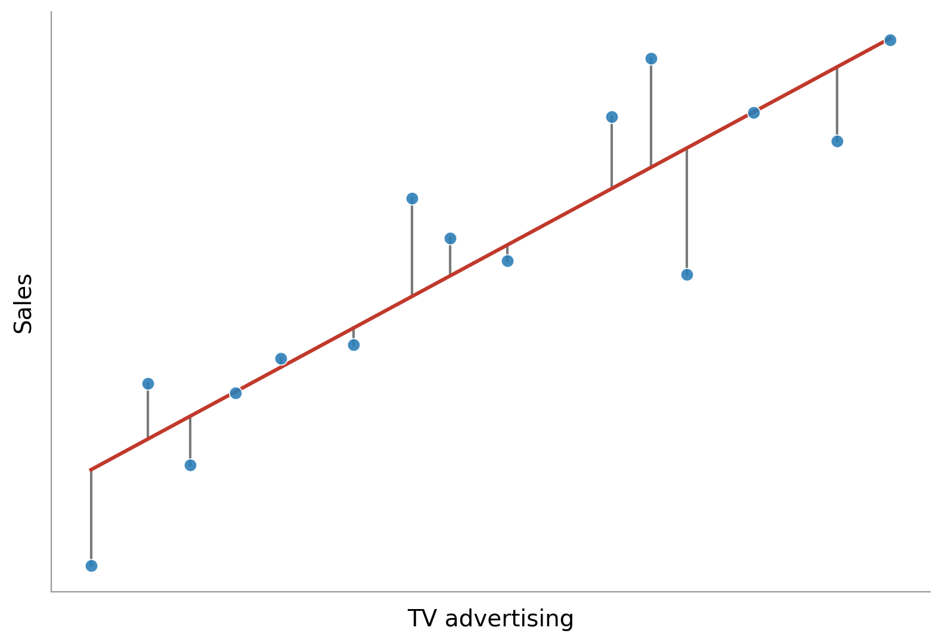
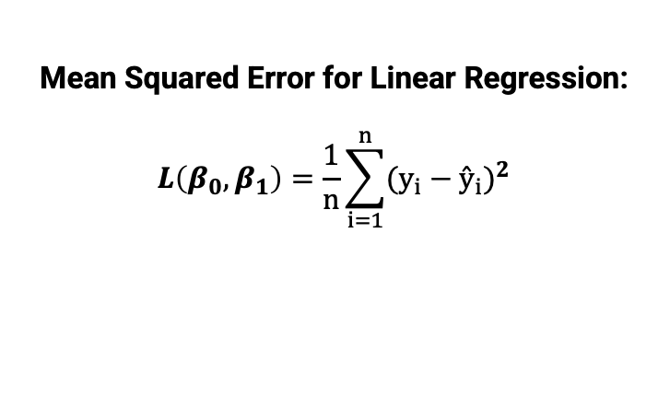
Loss for Linear Regression
Mean Squared Error for Linear Regression:
$$L\left(β_{0},β_{1}\right)=\frac{1}{n}\sum_{i=1}^{n}{{(y_{i}−{ŷ}_{i})}^{2}}$$
How far off are the predictions, on average?
Current model parameters

Slide 22
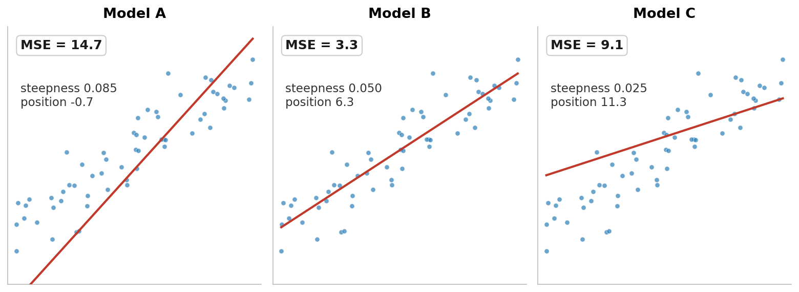
Loss for Linear Regression
Which set of parameters is best?

Slide 23
Model training
SUPERVISED MACHINE LEARNING WORKFLOW
GET LABELED DATA
How does one train a model?
Change the parameters to minimize the loss function.
SELECT MODEL
DEFINE LOSS
FUNCTION
MINIMIZE LOSS
EVALUATION

Slide 24
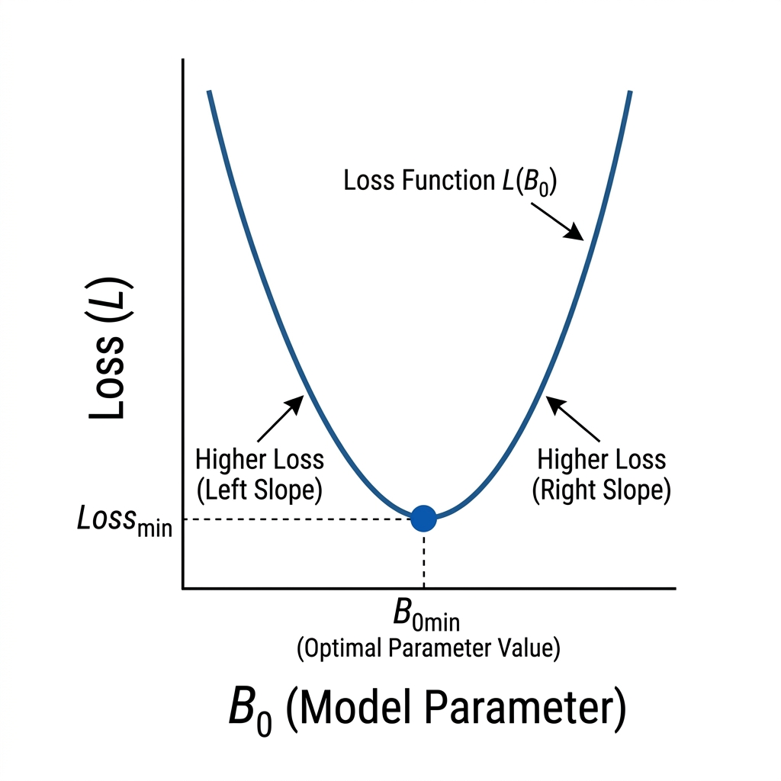
Model training – Brute Force
A way to estimate the optimal parameters is to calculate the loss function for every possible model parameter, then select the parameters where the loss function is smallest.

Slide 25
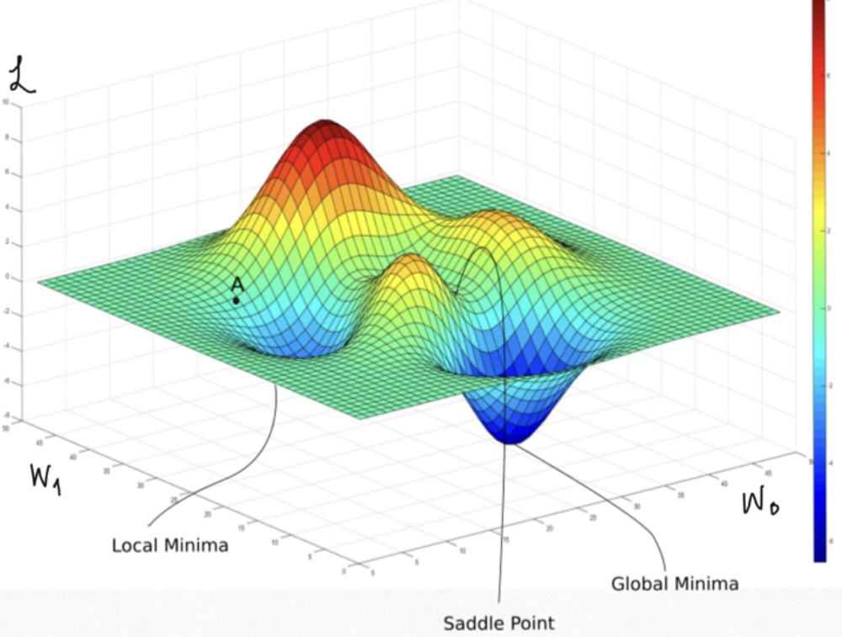
Model training – Gradient descent
Brute Force: Try every combination of parameters
Very computationally expensive
Exact: Solve the loss function analytically
Impossible to solve for many models
Greedy Algorithm: Gradient Descent
Not a guaranteed optimum, but works well in practice

Slide 26
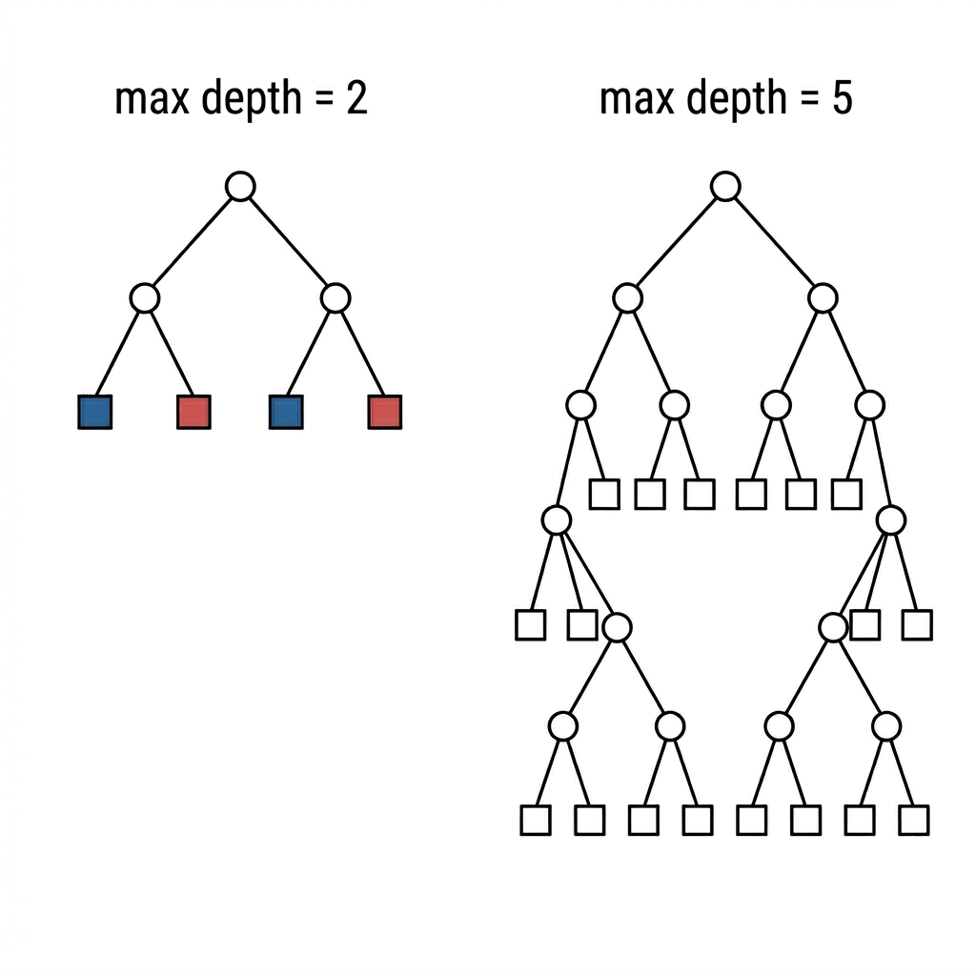

Parameters vs hyperparameters
Parameters: Training finds these:
Linear regression: the weights $β_{0},β_{1}$
Decision tree: each split
Hyperparameters: User sets these before training:
Linear regression: regularization strength, learning rate
Decision tree: maximum depth, minimum samples per leaf
If training picks the best parameters, how do you select the best hyperparameters?

Slide 27
evaluation
SUPERVISED MACHINE LEARNING WORKFLOW
GET LABELED DATA
Select the best hyperparameters.
Select the best candidate model.
Estimate true model performance.
SELECT MODEL
DEFINE LOSS
FUNCTION
MINIMIZE LOSS
EVALUATION

Slide 28
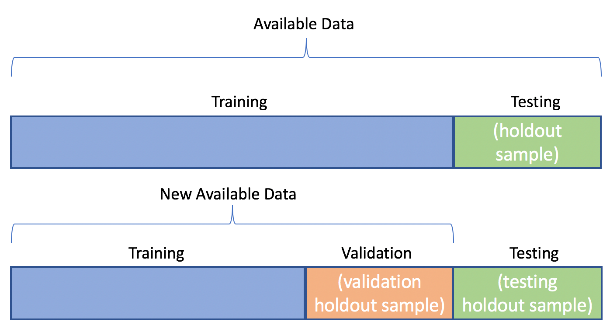
Train / Validation / test split
Split Data: Divide dataset into training, validation, and test.
Training Set – Used to fit the model parameters
Validation Set – Used to choose the hyperparameters
Test Set – Held out until the very end to provide an unbiased estimate of generalization performance.
Model Selection: Multiple candidate algorithms are compared based on performance metrics.

Slide 29
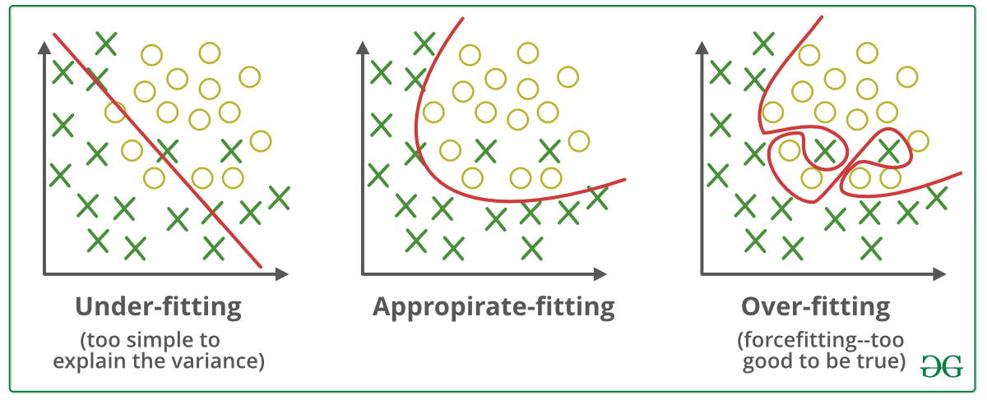
Underfitting vs overfitting

Slide 30
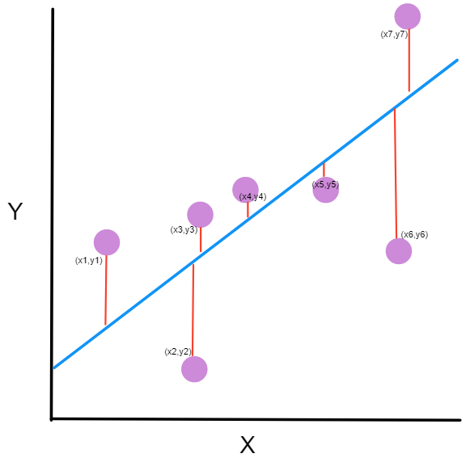
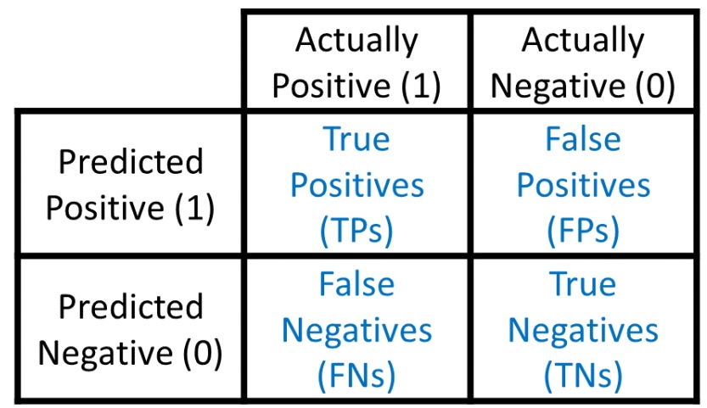
metrics
Evaluate Model Performance on the test set to estimate true generalization error:
Classification Metrics:
Accuracy – Proportion of correct predictions out of all predictions.
Precision – Proportion of positive predictions that were actually positive.
Recall – Proportion of positives correctly identified.
Regression Metrics:
MSE – Mean squared difference between predicted and actual values.
R2 – Proportion of variance in the target explained by the model.

Slide 31
Exercise
A fraud detection dataset contains 99% normal transactions and 1% fraudulent transactions.
You create a “dumb” model that predicts every single transaction is normal.
What is the accuracy of the model, and is this good?
A medical team creates a machine learning model to predict cancer diagnosis in patients.
It is critical that you catch every actual case of cancer. It is okay to flag healthy patients, but missing a sick patient is dangerous.
What metric should you prioritize?
A video recommendation algorithm must only show safe videos to children.
It is okay to miss some safe videos, but showing unsafe content is unacceptable.
What metric should you prioritize?
Notes:
Fraud: Accuracy would be 99%... But in reality, it does nothing and shows the fraudulent transactions.
Medical: Recall metrics would be good to use

